Slide 1


SmartParent Mobile Health: Teaching by Texting
Patricia Janssen, PhD
UBC School of Population and Public Health

Slide 2

Problem: Lack of prenatal education leads to adverse outcomes and higher medical costs

Slide 3
Prenatal education can prevent complications and reduce health care expenditures.
Healthy behaviours:
Appropriate weight gain
Prenatal care attendance
Routine screening tests
Avoiding tobacco, alcohol
Breastfeeding
Fewer complications:
Low birthweight
Cesarean birth
Preterm birth

Slide 4



Messages developed by experts
Our Solution
SmartParent delivers:
Three text messages per week
Evidence-based information endorsed by the SOGC and CPS
Info timed to week of pregnancy or infant age
Locally-relevant services and resources
Having an ultrasound before 20 weeks is important to ensure that your due date is accurate. Make an appt soon @bit.ly/
It’s almost time for your baby’s 6-month vaccination appointment. It’s important to get vaccinated on-time: bit.ly/
Notes:
SmartParent was developed to empower expectant and new parents with trustworthy information when they need it, to foster healthy behaviours. SmartParent delivers the right information, at the right time, directly to the people who need it.
We provide a comprehensive prenatal and first-year parenting education program delivered by text messaging. Evidence-based information is delivered in bite-sized portions, with 3 text messages per week, timed to the week of pregnancy or infant's age. Messages are positive, nudging healthy behaviours, and include a web link for more detail. We are the only digital education program endorsed by the Canadian Pediatric Society and the Society of Obstetricians and Gynecologists of Canada.

Slide 5


Targeted
Expectant Parents from 5-42 Weeks’ Gestation
Parents of Infants 0-12 Months Old

Slide 6

Why now?
Texts are a low barrier solution
Fewer than 30%
of Canadians attend in person prenatal classes
Digital is the norm
More than 90%
of Canadians have a cell phone
Texts are received passively
More than 95%
of text messages are opened
Effective

Slide 7

Effective
USA - RCT of the Text4Baby program in the USA reported higher rates of alcohol reduction¹
South Africa, an RCT improved PNC attendance, increased rates of VBAC and decreased LBW²
Zanzibar - Decreased perinatal mortality³
Thailand - lowered levels of anxiety⁴
Reduced rates of macrosomia in China⁵
Meta-analytical evidence suggests higher rates of breast feeding⁶
1. Evans DR, Dose-response effects of the Text4Baby mobile health program: randomized controlled trial. JMIR mHealth uHeal 2015;3:e12.
2. Coleman J, Effectiveness of an SMS-based maternal mHealth intervention to improve clinical outcomes of HIV-positive pregnant women. AIDS
Care 2017;29:890–7.
3. Lund S, Mobile phone intervention reduces perinatal mortality in Zanzibar: secondary outcomes of a cluster randomized controlled trial. JMIR Mhealth Uhealth 2014;2:e15.
4. Jareethum R. Satisfaction of health pregnant women receiving short message service via mobile phone for prenatal support: a randomized controlled trial. J Med Assoc Thai 2008;91:458–63.
5. Zhou Z, The effects on inappropriate weight for gestational age of an SMS based educational intervention for pregnant women in Xi’An China: a quasi-randomized controlled trial. Int J Environ Res Public Health 2020;17:1482.
6. Lee SH, Nurmatov UB, Nwaru BI, et al. Effectiveness of mHealth interventions for maternal, newborn and child health in low-and middle-income
countries:systematic review and meta-analysisJ Glob Health 2016;6:010401.

Slide 8
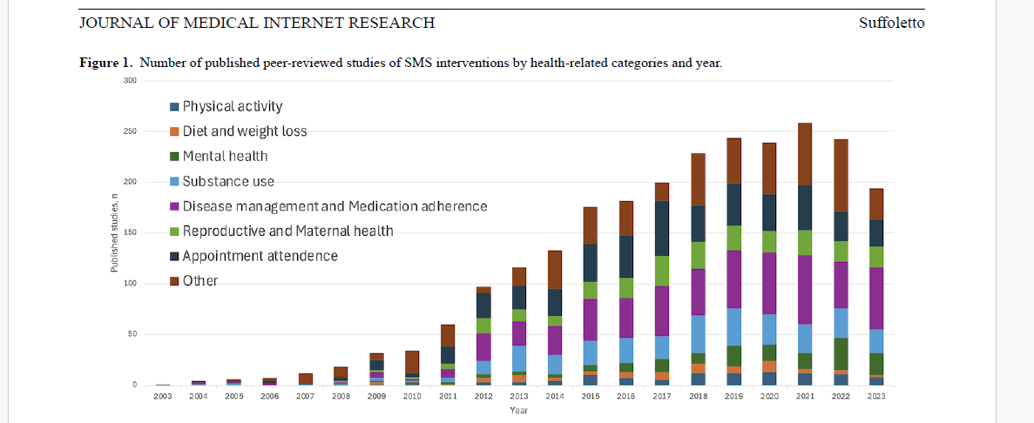
Other Evaluation Studies

Slide 9

Why would text messages change behaviour?
Social Cognitive Theory
Modeling healthy behaviours through messages promotes self-efficacy
Health Belief Model
Text messages serve as a cue to action with salient information providing just-in-time tips
The Theory of Planned Behavior
Beliefs and attitudes change when messages are received at the point of decision-making

Slide 10

Superpowers of SMS – What fosters engagement?
Low Barrier
In a 2023 pop’n based study in the US and Canada (n=1019) States and Canada:
70% texting is the fastest way to reach them
74% read every text
62% read texts within a few minutes. 2024 State of business texting report. Text Request
Can’t turn off notifications
“Push” technology, delivering messages
directly to individuals
without any effort on their part
Microdoses of information support
Immediate
Context-relevant

Slide 11
Interactive
Links to videos, feedback on quizzes.
Texting is a proven method for changing behaviour
Evidence-based
Endorsement by national health care organizations
Customizable message content for individuals and health authorities
Single use messages to deal with time-sensitive issues, i.e. heat wave.
Health care cost savings of $374 per user -@ $21 cost to deliver
Sales and marketing to secure more customers across Canada, expand technology from SMS text to alternate API platforms
Proven
Trusted
Adaptable
Cost Effective

Slide 12
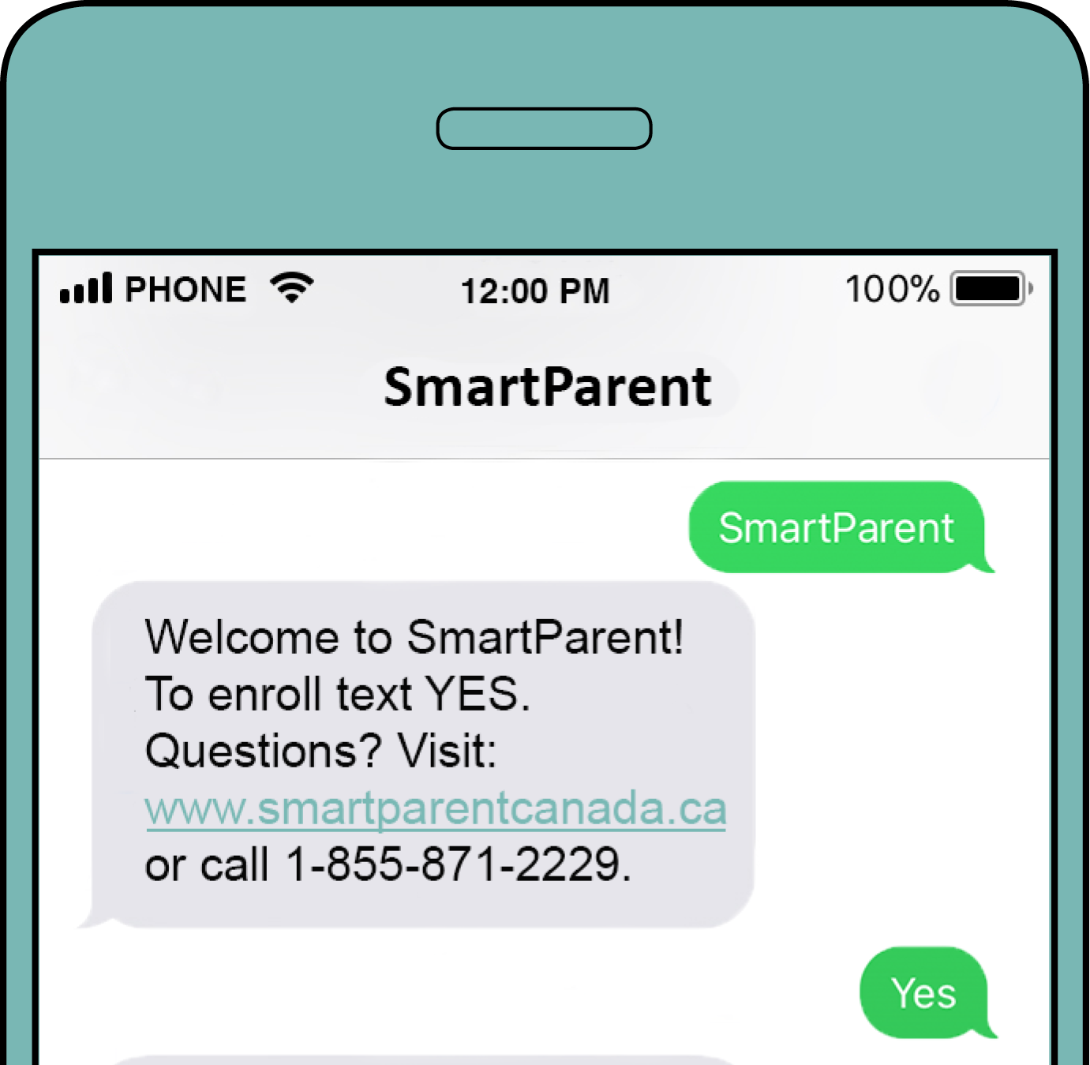
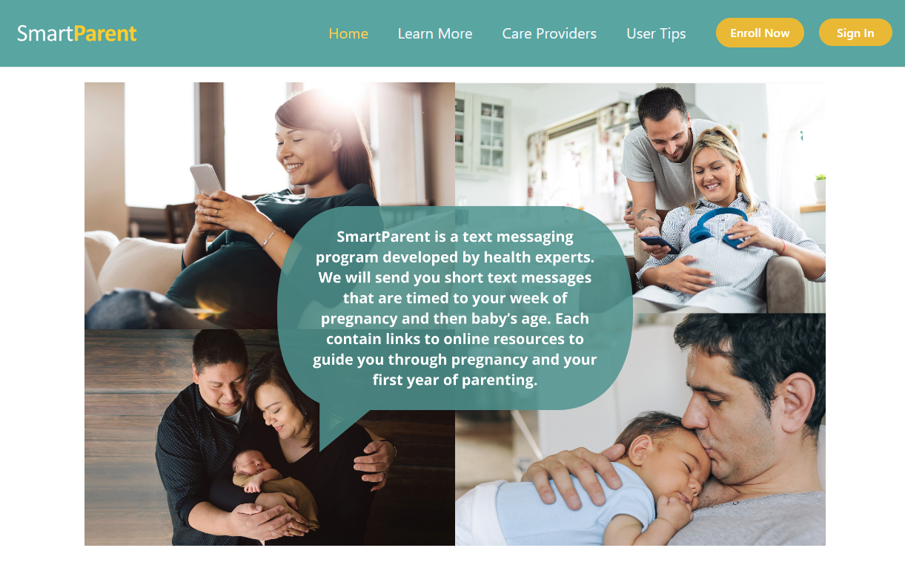
Text keyword SmartParent to phone number 12323
Click Enroll Now at SmartParent.ca
Notes:
People can enroll anytime during pregnancy or their baby's first year with easy enrollment by texting or via our website.

Slide 13











Meets Individual Needs
Users can subscribe to multiple messaging streams. 49% of them choose one or more of the following streams:
Do you have questions about smoking and pregnancy? Join the discussion @ bit.ly/
Smoking
Depression
Pregnancy Loss
Alcohol/ Substance use
Weight
management
Pregnancy Over 35
Mood swings are normal during pregnancy – how mild or intense are your symptoms? Find out if depression is beginning @ bit.ly/
New Immigrants
Planning a Vaginal Birth After a Previous Cesarean Delivery
Exposure to Violence

Slide 14
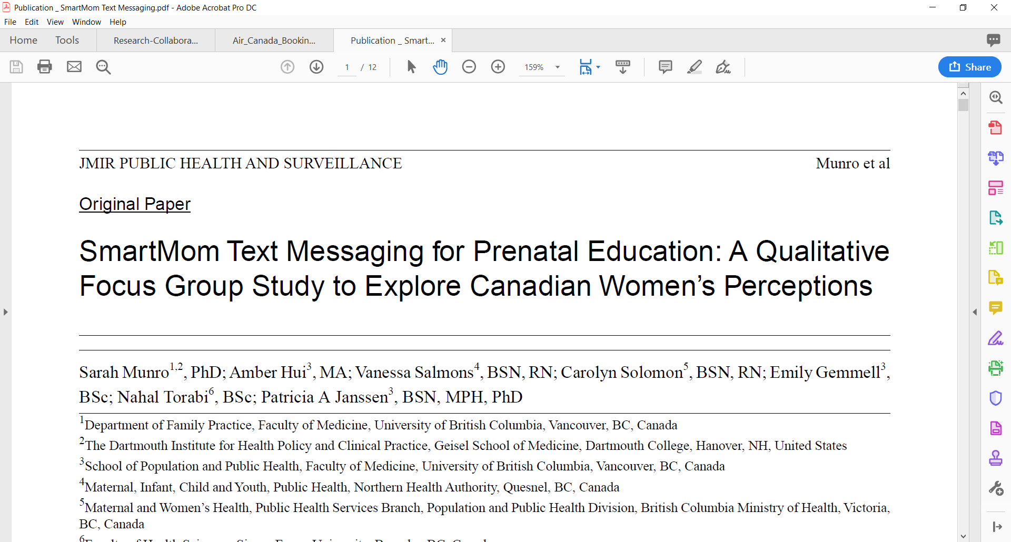
Enhances knowledge of options and ability to ask questions
Convenient, immediate
Encouraging, not fear-based
Resource information local and reliable
Motivates discussion with caregiver
Relevance and need for “opt-in” topics

Slide 15
Fathering Outcomes
Fathering Outcomes
SMS texting lessens a sense of isolation, promotes father-infant bonding, supports the farther-partner relationship.
Structural
Synching information to needs
Normalization
Prompts to interact
Provision of a safety net
Psychological
Increase in knowledge
Feelings of confidence
Ability to cope
Role orientation
Feeling connected
Fletcher, BMC Psychology 2019
Notes:
The other references were more appropriate to SmartMom than to SmartParent

Slide 16
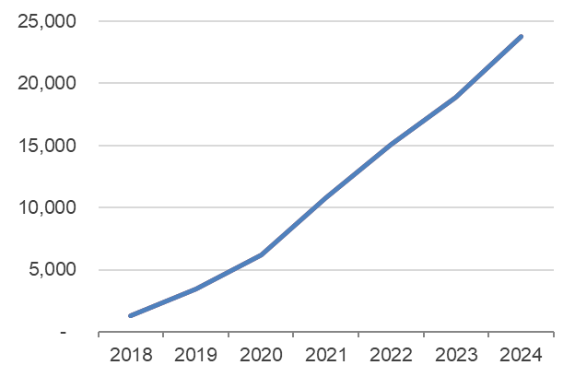

Traction in BC
Demonstrated uptake and value
User Growth
Engagement
78%
read 75-100% of messages
Value
63%
87%
93%
report half or more of the information is new
rated information as good or excellent
would recommend to a friend

Slide 17

SmartParent has a measurable impact on the health of mothers and infants.

Slide 18






Changing Behaviour
Before pregnancy
During or after pregnancy
75% quit
50% stated SmartParent influenced their smoking behaviour
6.2%
smoked
90.5% quit
26% stated SmartParent influenced their cannabis behaviour
12.7%
consumed cannabis
99.2% quit
12%stated SmartParent influenced their alcohol behaviour
52.2%
drank alcohol
At end of pregnancy, users exercised 20 min or more for an average of 3.6 days per week 42.7% stated SmartParent influenced their exercise behaviour

Slide 19

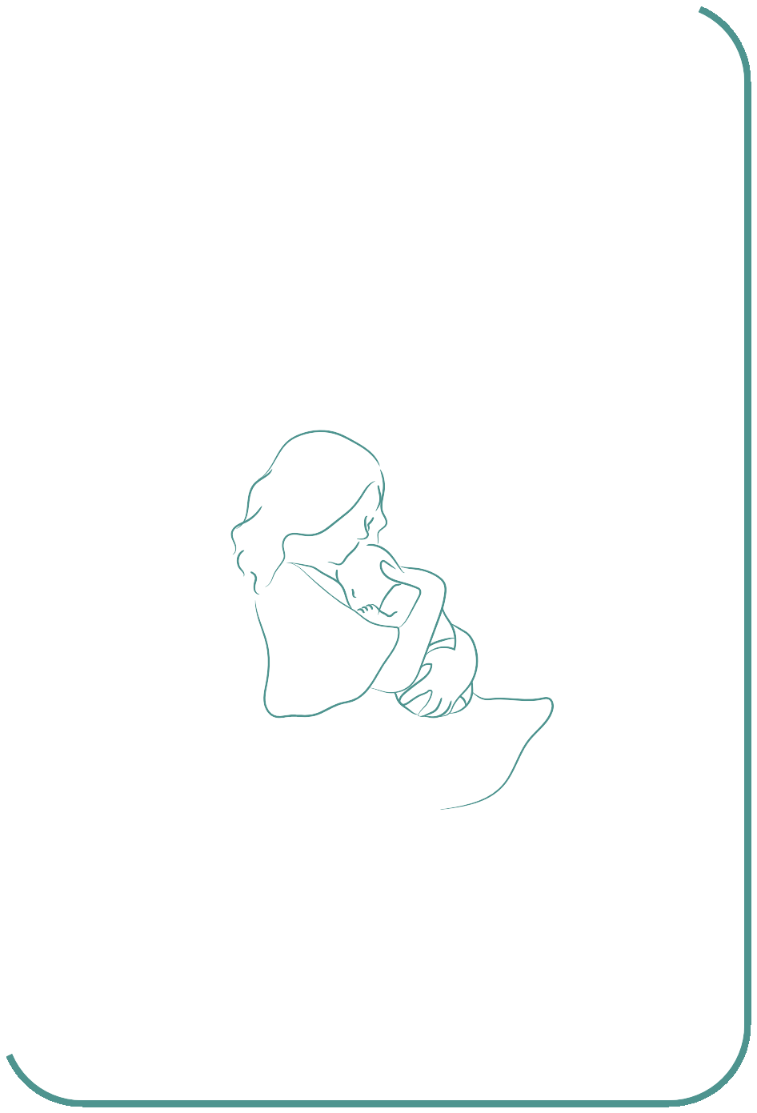

Reversing Trends in Mental Health Outcomes
1
Increase in knowledge on how to have a healthy pregnancy & birth
2
Decrease in fear of childbirth
3
Decrease in depression
7.6 (1.3) → 8.4 (1.2)
mean (sd)
Based on knowledge test (10 items)
29.4 (7.4) → 27.6 (7.7)
mean (sd)
Based on Fear of Childbirth questionnaire (12 items, score 0-60)
6.8 (4.5) → 5.8 (4.5)
mean (sd)
Based on Edinburgh Postnatal Depression Scale (10 items, score 0-30)

Slide 20
Maternal Outcomes – Data Source Perinatal Services BC 2017-2023
Outcome | SmartParent | Control | p-value
 | n=808 | n=2683
Number of antenatal visits, mean (sd) | 9.55 (3.50) | 9.22 (3.46) | 0.02
Cervical dilation on admission in cm, mean (sd) (spontaneous labours) | 5.25 (2.40) | 4.83 (2.25) | 0.007
Cervical dilation < 3 cm on admission | 32 (10.5%) | 150 (14.2%) | 0.09
Attempted VBAC (among VBAC eligible) | 7 (35.0%) | 14 (27.5%) | ns
Cesarean Birth | 361 (42.3) | 1151 (41.6) | ns
Labour Augmentation | 265 (37.2%) | 985 (42.5%) | 0.01
Labour Induction | 289 (40.6%) | 874 (37.7%) | ns
Postpartum hospital length of stay in hours, mean (sd) | 49.5 (31.7) | 51.3 (37.3) | 0.10
No difference in neonatal outcomes

Slide 21

“SmartParent is a reliable source and you can trust that. When you go to Google, you can find anything. It [the Internet] is very scary sometimes. But if you have a reputable text and you know where it’s coming from and you trust the source, then you’re more likely to go to that resource and believe it and seek it out.”
smartparentcanada.ca
1- 855-871-BABY (2229)
contact@smartparentcanada.ca
Patricia Janssen, PhD, Lead
patti.janssen@ubc.ca
Kara Allanach, MSc, Coordinator klallanach@gmail.com

